Slide 1
Design Specification
By: Team 4D

Slide 2
Team 4D - Car Marketplace
Goal: building an intuitive yet extensive marketplace to aid car sales for the right prices and help people make their dream purchase.
Target audience: This is a virtual garage sale accessible to everyone, whether a major reseller or your neighbour from across the street. The show-off car enthusiast, or the mum of 3 trying to make ends meet.
Functionality: Each car has its own specific details and reviews. Cars can also be filtered by brand, quality of use and more. This allow users to pick their future car carefully.

Slide 3
Requirements
User registration and authentication (users should be able to create an account and log in to the platform)
Vehicle listings and search (users should be able to search for vehicles based on various criteria, such as make, model, year, price range, location, etc. They should be able to sort based on various criteria too. Sellers should be able to list their vehicles for sale, including uploading photos and providing detailed descriptions)
Detailed vehicle information and photos (display detailed information about each vehicle, including photos, specifications, features, and seller information)
Contact and communication between buyers and sellers (the app must enable buyers and sellers to communicate with each other through a messaging system. This will allow users to ask questions, negotiate prices, and arrange meetings)
Reviews and ratings: The app must allow users to rate and review sellers. This will enable buyers to make informed decisions and help sellers build their reputation.

Slide 4

Persona One
Warm welcome to Sin, 28. He managed to make a lot of money through questionable routes, but nevertheless he arrives to our virtual marketplace hungry. He already owns 5 luxury cars, but what's stopping him from acquiring (and modding) a new one? Not us! Sin is looking for the shiniest and fastest models of the market. Likely to be sorting by price descending despite having to scroll a bit.

Slide 5

Persona Two
This is Lizzy, 37. She does not have too much going for her financially, but she's never giving up. Lizzy is not looking for something pricey, she will have a quick look at the used section, as she needs something to just ride her 2 kids to lessons with, and call it a day. Value for money is of outermost importance for her!

Slide 6

Persona Three
Finally, Tanya, 43. Despite being “more of a horse girl”, she's working as an agent representing a major automobile resale firm, and she's working on commission. She'll do her absolute best to maximize her company's profits by supplying with attractive pictures and descriptions of the car's she's managing. She will be responding to clients’ enquiries whenever her busy schedule allows for that and hope for the best.

Slide 7
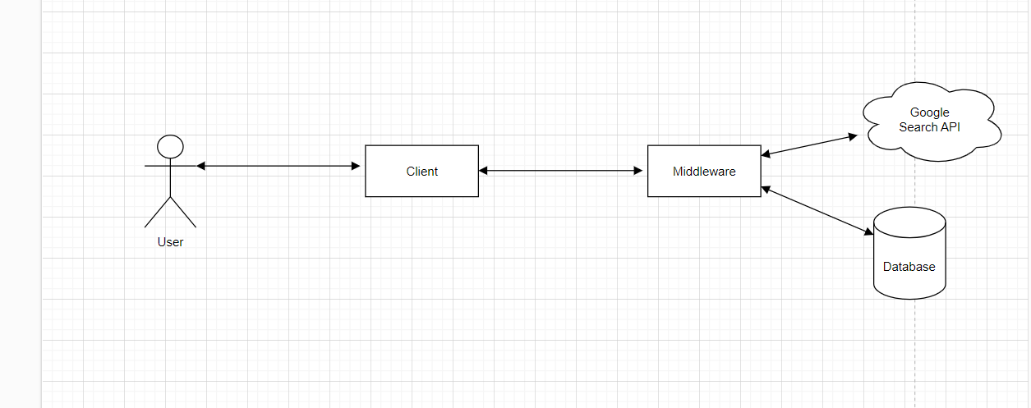
System Architecture

Slide 8
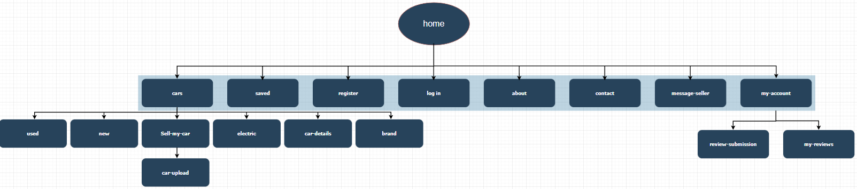
Site Map

Slide 9
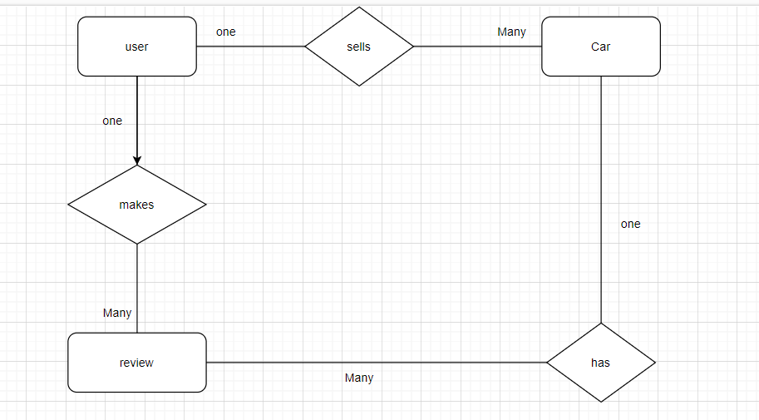
ER diagram

Slide 10
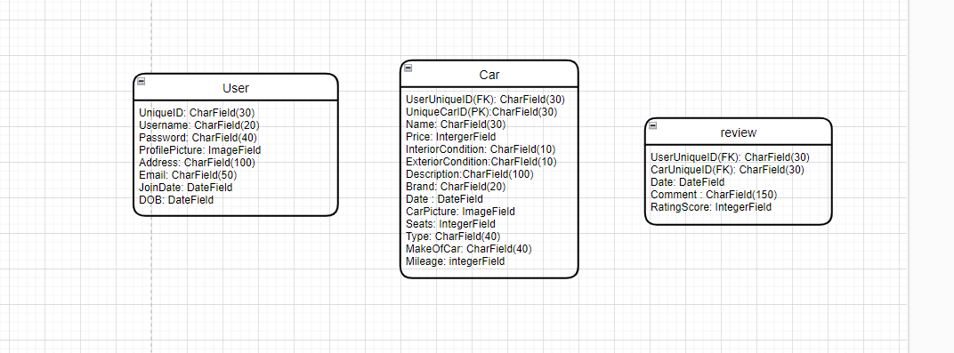
ER Diagram entity attributes and fields

Slide 11
URLS
-/Home
-/Home/Cars
-/Home/Cars/New
- /Home/Cars/Used
-/Home/Cars/Sell-My-Car
-/Home/Sell-Cars/Car-Upload
-/Home/Cars/Electric
-/Home/Cars/Car-Details
-/Home/Cars/Car-Brand
-/Home/Log-In
-/Home/Register
-/Home/Contact-Us

Slide 12
URLS continued
-/Home/About-Us
-/Home/Saved
-/Home/My-Account
-/Home/My-Account/My-Reviews
-/Home/My-Account/Review-Submission
-/Home/Message-Seller

Slide 13
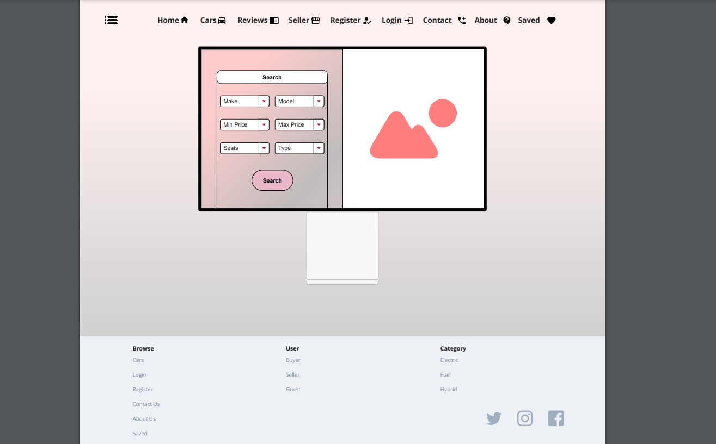
Wireframes

Slide 14
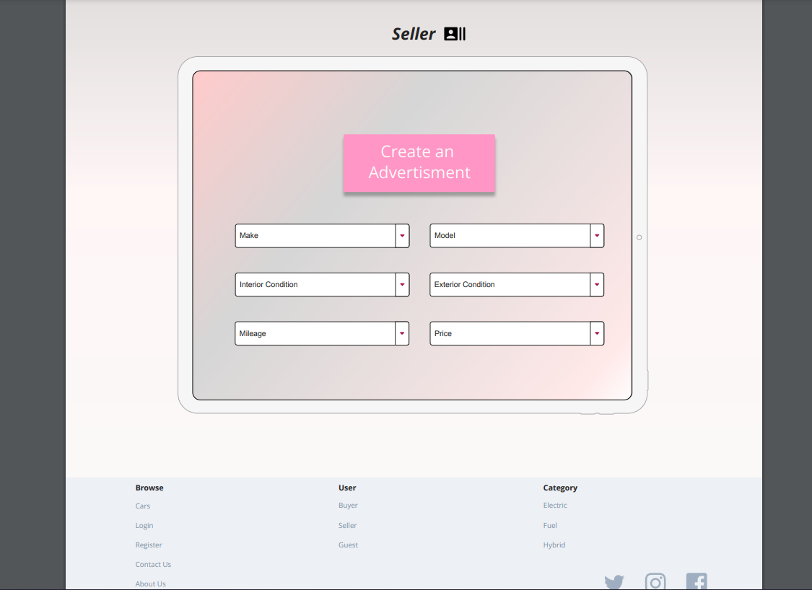
Wireframes

Slide 15
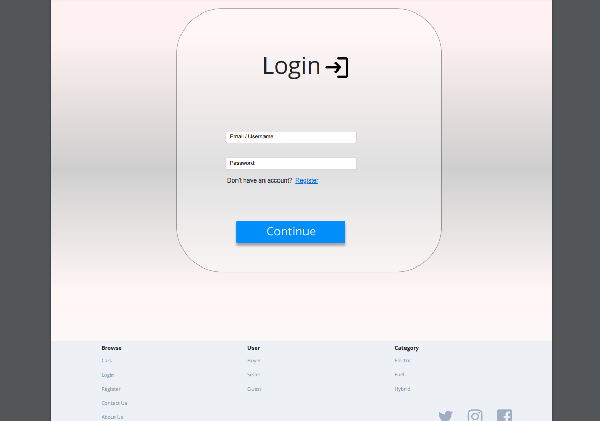
Wireframes

Slide 16
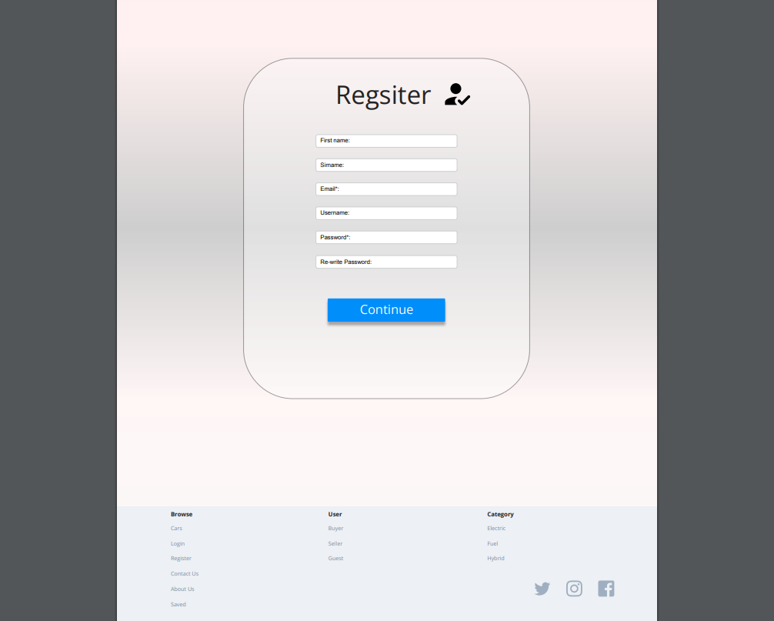
Wireframes

